Slide 1
Neural Networks Basics
Dai Bui

Slide 2




















Simple Neural Network
$$x_{0}$$
$$w_{00}$$
$$w_{02}$$
$$w_{01}$$
$$y_{0}$$
$$y=W^{T}x+b$$
$$x_{1}$$
$$w_{10}$$
$$w_{11}$$
$$w_{12}$$
$$y_{1}$$
$$w_{20}$$
$$x_{2}$$
$$w_{21}$$
$$w_{22}$$
$$y_{2}$$
$$w_{30}$$
$$w_{31}$$
$$x_{3}$$
$$w_{32}$$

Slide 3

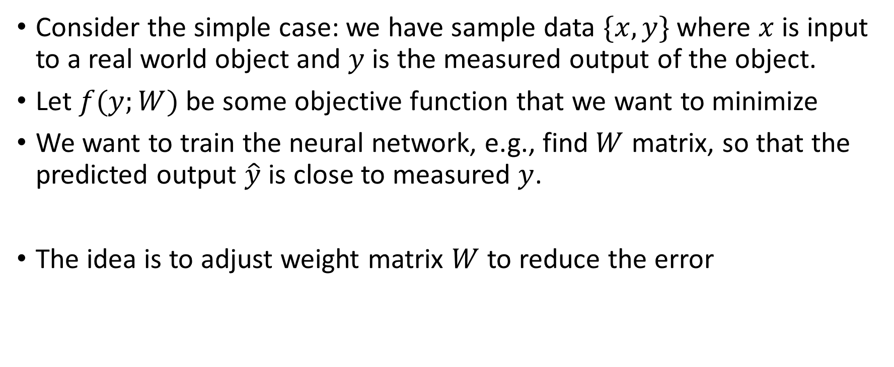
Simple Neural Network
Consider the simple case: we have sample data $\{x,y\}$ where $x$ is input to a real world object and $y$ is the measured output of the object.
Let $f(y;W)$ be some objective function that we want to minimize
We want to train the neural network, e.g., find $W$ matrix, so that the predicted output $\hat{y}$ is close to measured $y$.
The idea is to adjust weight matrix $W$ to reduce the error
$${\left\|f\left(\hat{y};W\right)−f\left(y;W\right)\right\|}^{2}≈0$$

Slide 4
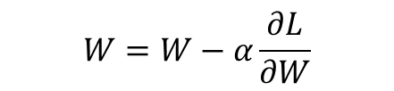

Neural Networks Training
Neural networks training is composed of two phases
Forward propagation: $\hat{y}=W^{T}x+b$
Backward propagation
Compute error: $L\left(W\right)={\left\|f\left(\hat{y};W\right)−f\left(y;W\right)\right\|}^{2}$
Propagate the error $e$ back to adjust $W$ using the gradient descent method
$$W=W−α\frac{∂L}{∂W}$$

Slide 5








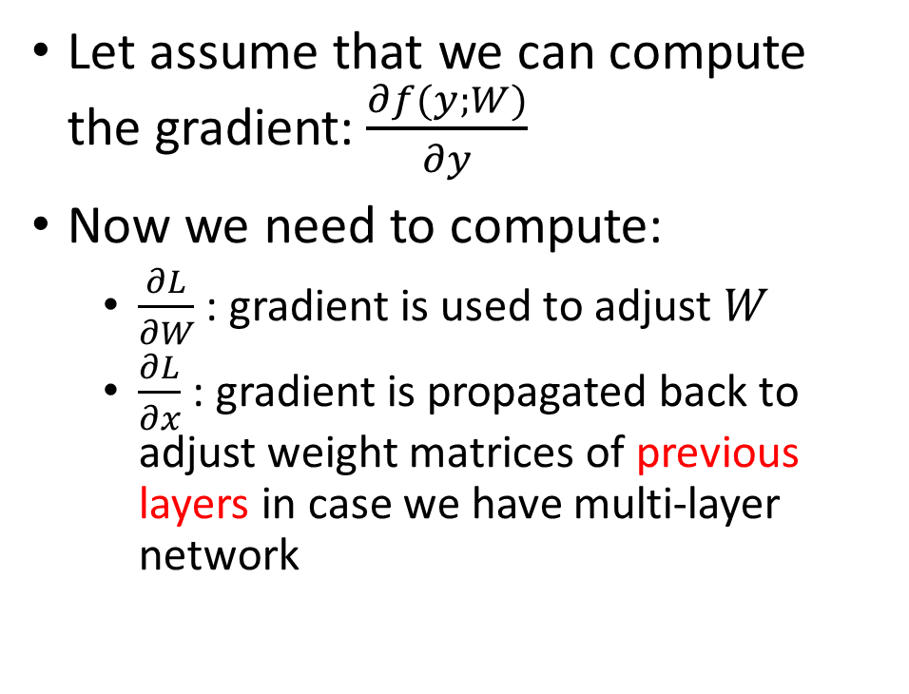














Backpropagation
Let assume that we can compute the gradient:$\frac{∂f(y;W)}{∂y}$
Now we need to compute:
$\frac{∂L}{∂W}$ : gradient is used to adjust $W$
$\frac{∂L}{∂x}$ : gradient is propagated back to adjust weight matrices of previous layers in case we have multi-layer network
$$x_{0}$$
$$\frac{∂L}{∂y_{0}}$$
$$w_{00}$$
$$w_{02}$$
$$w_{01}$$
$$y_{0}$$
$$x_{1}$$
$$w_{10}$$
$$w_{11}$$
$$\frac{∂L}{∂y_{1}}$$
$$w_{12}$$
$$w_{20}$$
$$y_{1}$$
$$x_{2}$$
$$w_{21}$$
$$\frac{∂L}{∂y_{2}}$$
$$w_{22}$$
$$w_{30}$$
$$w_{31}$$
$$y_{2}$$
$$x_{3}$$
$$w_{32}$$

Slide 6
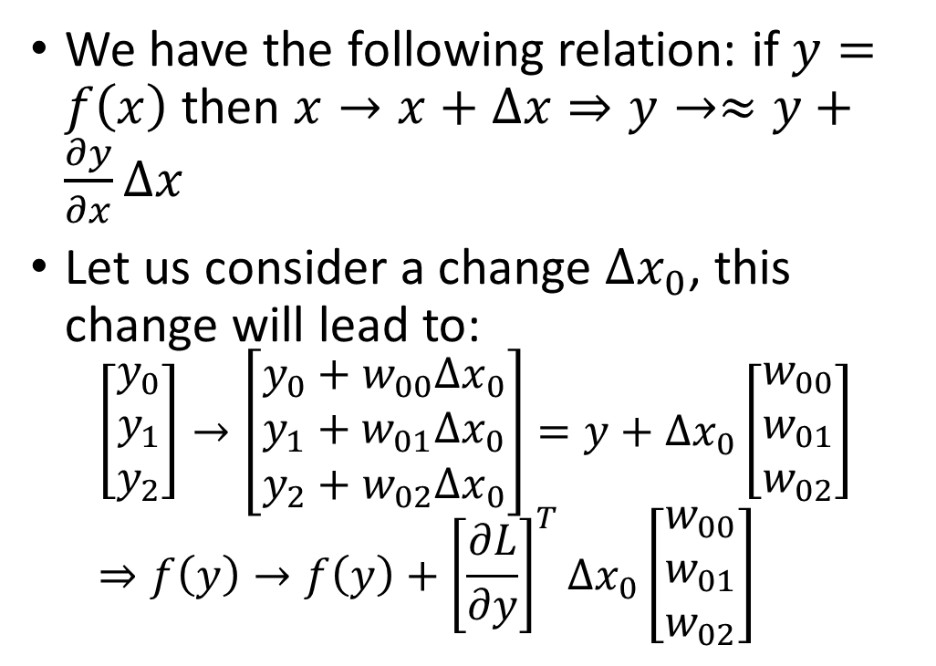
Backpropagation Intuition
We have the following relation: if $y=f\left(x\right)$then $x→x+∆x⇒y→≈y+\frac{∂y}{∂x}∆x$
Let us consider a change $∆x_{0}$, this change will lead to:
$$\left[\begin{matrix}y_{0} \\ y_{1} \\ y_{2}\end{matrix}\right]→\left[\begin{matrix}y_{0}+w_{00}∆x_{0} \\ y_{1}+w_{01}∆x_{0} \\ y_{2}+w_{02}∆x_{0}\end{matrix}\right]=y+∆x_{0}\left[\begin{matrix}w_{00} \\ w_{01} \\ w_{02}\end{matrix}\right]⇒f\left(y\right)→f\left(y\right)+{\left[\frac{∂L}{∂y}\right]}^{T}∆x_{0}\left[\begin{matrix}w_{00} \\ w_{01} \\ w_{02}\end{matrix}\right]$$
$$x_{0}$$
$$\frac{∂L}{∂y_{0}}$$
$$w_{00}$$
$$w_{02}$$
$$w_{01}$$
$$y_{0}$$
$$x_{1}$$
$$w_{10}$$
$$w_{11}$$
$$\frac{∂L}{∂y_{1}}$$
$$w_{12}$$
$$w_{20}$$
$$y_{1}$$
$$x_{2}$$
$$w_{21}$$
$$\frac{∂L}{∂y_{2}}$$
$$w_{22}$$
$$w_{30}$$
$$w_{31}$$
$$y_{2}$$
$$x_{3}$$
$$w_{32}$$

Slide 7

Backpropagation Intuition
In short, a change $∆x_{0}$will lead to an approximate change of ${\left[\frac{∂L}{∂y}\right]}^{T}∆x_{0}\left[\begin{matrix}w_{00} \\ w_{01} \\ w_{02}\end{matrix}\right]$in the objective function
$$\frac{∂L}{∂x_{0}}=\lim_{{∆x}_{0}→0}{\frac{\left(L\left(y\right)+{\left[\frac{∂L}{∂y}\right]}^{T}∆x_{0}\left[\begin{matrix}w_{00} \\ w_{01} \\ w_{02}\end{matrix}\right]\right)−L(y)}{∆x_{0}}={\left[\frac{∂L}{∂y}\right]}^{T}\left[\begin{matrix}w_{00} \\ w_{01} \\ w_{02}\end{matrix}\right]=\frac{∂L}{∂y_{0}}w_{00}+\frac{∂L}{∂y_{1}}w_{01}+\frac{∂L}{∂y_{2}}w_{02}}$$

Slide 8

Backpropagation Mathematically
By the chain rule, we know
$\frac{∂L}{∂x_{0}}=\frac{∂L}{∂y}\frac{∂y}{∂x_{0}}={\left[\begin{matrix}\frac{∂L}{∂y_{0}} \\ \frac{∂L}{∂y_{1}} \\ \frac{∂L}{∂y_{2}}\end{matrix}\right]}^{T}\left[\begin{matrix}w_{00} \\ w_{01} \\ w_{02}\end{matrix}\right]=\frac{∂L}{∂y_{0}}w_{00}+\frac{∂L}{∂y_{1}}w_{01}+\frac{∂L}{∂y_{2}}w_{02}$

Slide 9
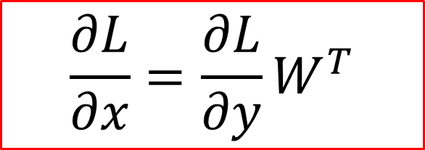
Backpropagation Input Gradient
$$\frac{∂L}{∂x}=\frac{∂L}{∂y}W^{T}$$

Slide 10
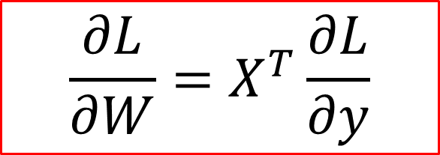
Backpropagation Weight Gradient
$$\frac{∂L}{∂W}=X^{T}\frac{∂L}{∂y}$$

Slide 11
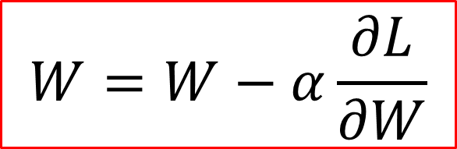
Gradient Descent
$$W=W−α\frac{∂L}{∂W}$$

Slide 12
Multilayer Neural Networks

Slide 13
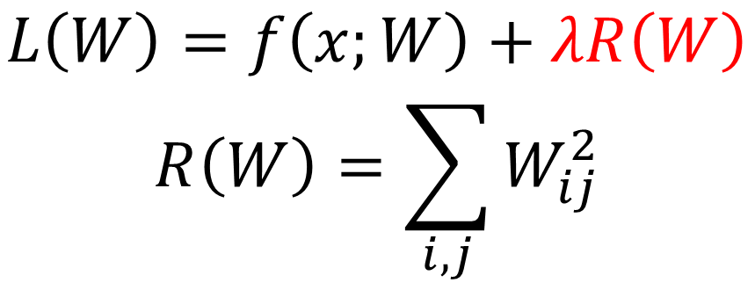
Regularization
In case we use too many layers as well as too wide hidden layers, it is very easy to fit the data when training but prediction is often wrong. This is the overfitting problem
To mitigate the problem, we add a regularization factor to reduce the number of weights used.
$$L\left(W\right)=f\left(x;W\right)+λR\left(W\right)$$
$$R\left(W\right)=\sum_{i,j}{W_{ij}^{2}}$$

Slide 14

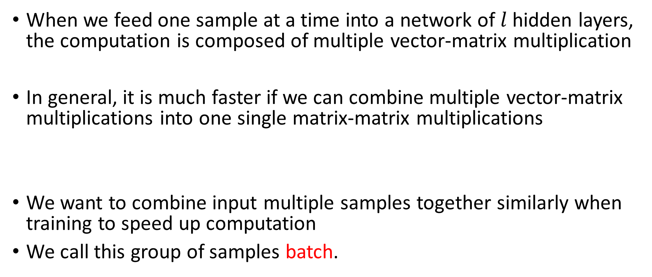
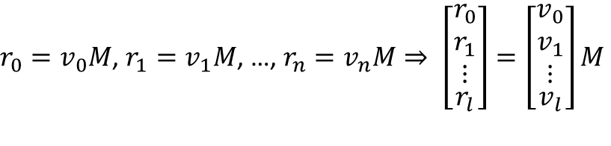
Vectorizing Across Multiple Samples
When we feed one sample at a time into a network of $l$ hidden layers, the computation is composed of multiple vector-matrix multiplication
In general, it is much faster if we can combine multiple vector-matrix multiplications into one single matrix-matrix multiplications
We want to combine input multiple samples together similarly when training to speed up computation
We call this group of samples batch.
$$y=(\left(xW_{1}+b_{1}\right)…W_{l})+b_{l}$$
$r_{0}=v_{0}M$, $r_{1}=v_{1}M$, …, $r_{n}=v_{n}M⇒ \left[\begin{aligned}\begin{matrix}r_{0} \\ r_{1} \\ ⋮\end{matrix} \\ r_{l}\end{aligned}\right]=\left[\begin{aligned}\begin{matrix}v_{0} \\ v_{1} \\ ⋮\end{matrix} \\ v_{l}\end{aligned}\right]M$

Slide 15

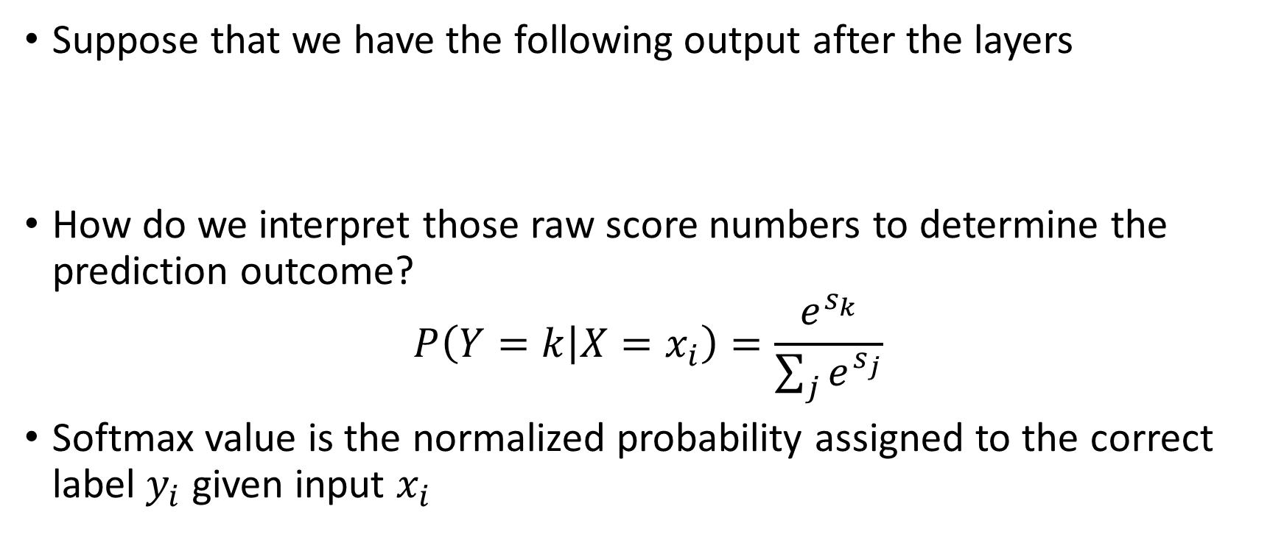
Softmax Classifier
Suppose that we have the following output after the layers
How do we interpret those raw score numbers to determine the prediction outcome?
$$P\left(Y=k | X=x_{i}\right)=\frac{e^{s_{k}}}{\sum_{j}{e^{s_{j}}}}$$
Softmax value is the normalized probability assigned to the correct label $y_{i}$ given input $x_{i}$
cat | 3.2
car | 5.1
frog | -1.7
0.13
0.87
0.00
1
0
0
softmax
How do we compare?

Slide 16
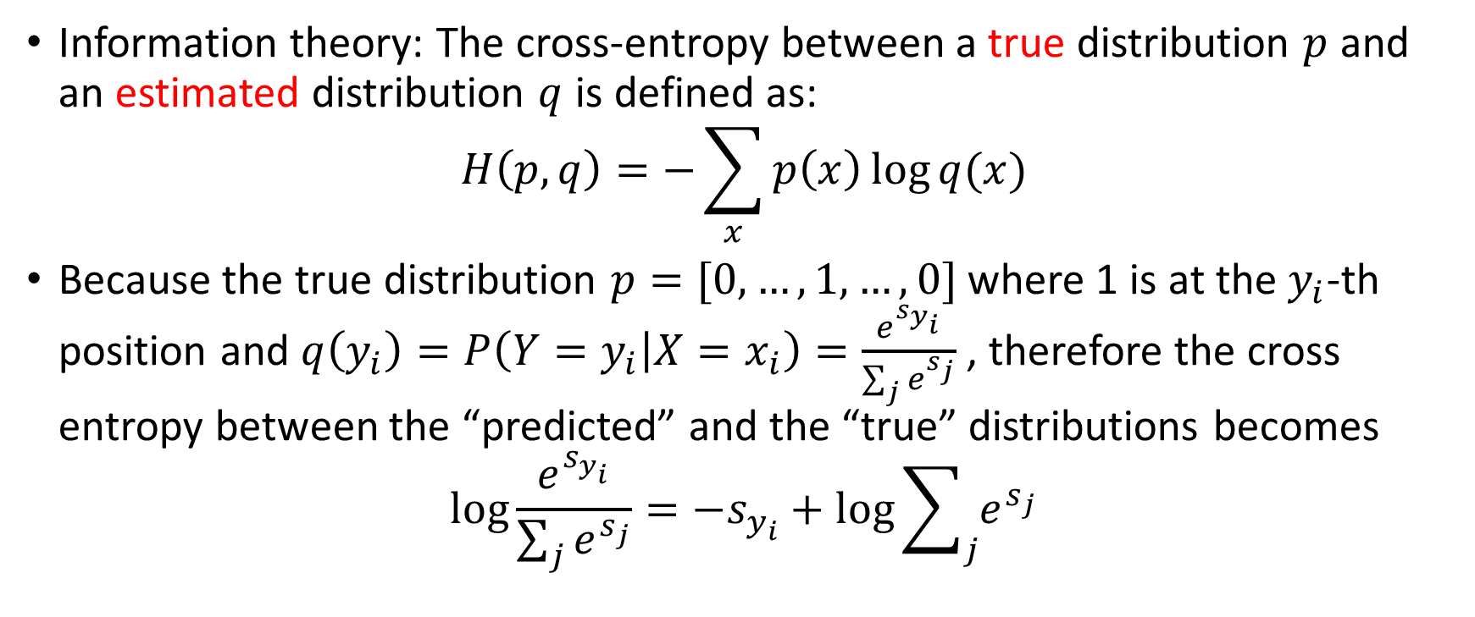
Cross Entropy
Information theory: The cross-entropy between a true distribution $p$ and an estimated distribution $q$ is defined as:
$$H\left(p,q\right)=−\sum_{x}{p\left(x\right)\log{q(x)}}$$
Because the true distribution $p=[0, …,1, …,0]$ where 1 is at the $y_{i}$-th position and $q\left(y_{i}\right)=P\left(Y=y_{i} | X=x_{i}\right)=\frac{e^{s_{y_{i}}}}{\sum_{j}{e^{s_{j}}}}$ , therefore the cross entropy between the “predicted” and the “true” distributions becomes
$$\log{\frac{e^{s_{y_{i}}}}{\sum_{j}{e^{s_{j}}}}={−s}_{y_{i}}+\log{\sum_{j}{e^{s_{j}}}}}$$

Slide 17
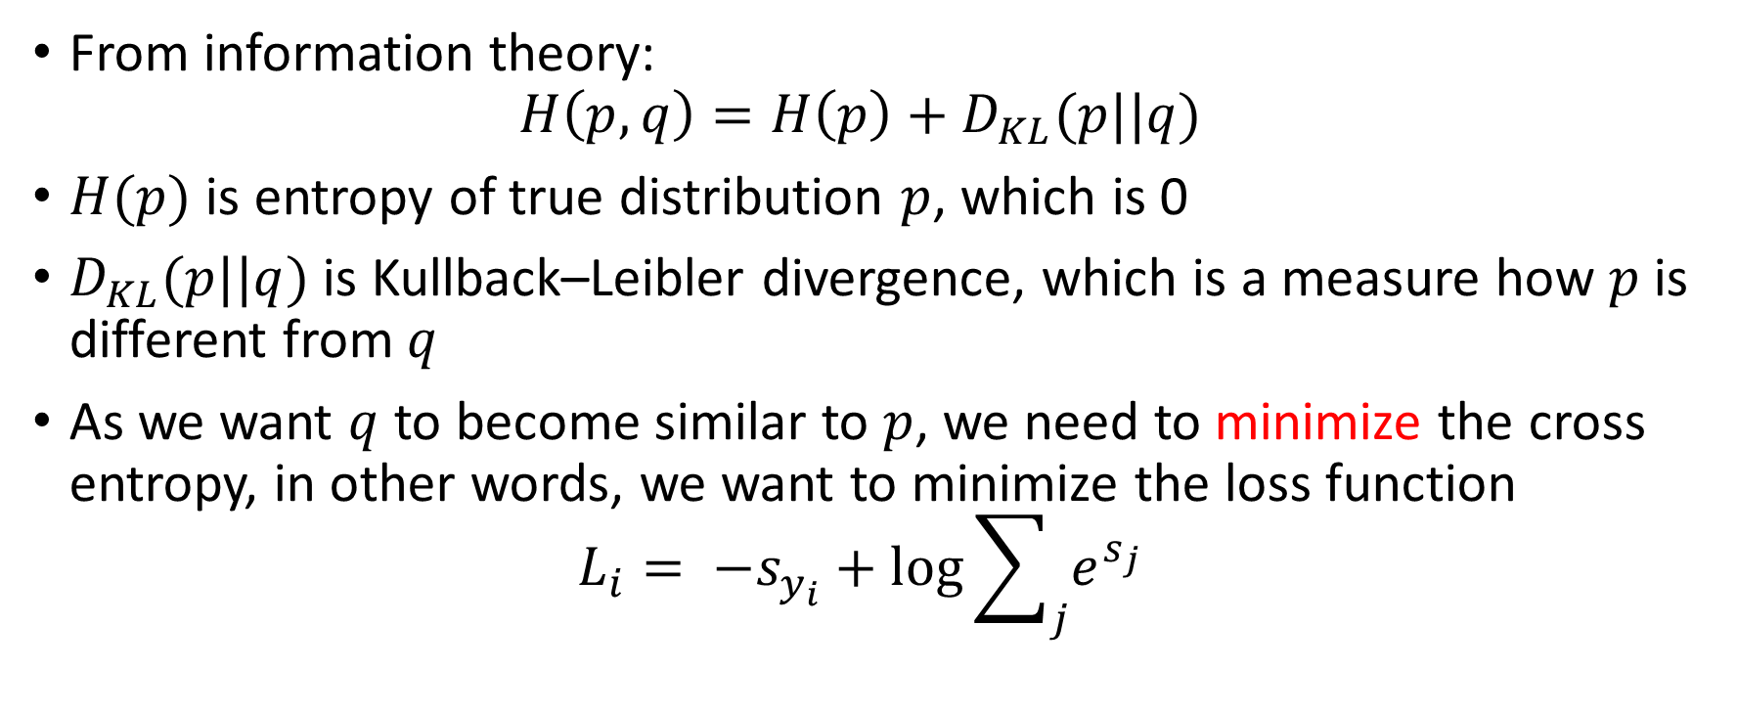
Cross Entropy Loss
From information theory:
$$H\left(p,q\right)=H\left(p\right)+D_{KL}(p||q)$$
$H(p)$ is entropy of true distribution $p$, which is 0
$D_{KL}(p||q)$ is Kullback–Leibler divergence, which is a measure how $p$ is different from $q$
As we want $q$ to become similar to $p$, we need to minimize the cross entropy, in other words, we want to minimize the loss function
$${L_{i}= −s}_{y_{i}}+\log{\sum_{j}{e^{s_{j}}}}$$

Slide 18

Cross Entropy Loss
Notice that
$$L_{i}=−\log{P\left(Y=y_{i} | X=x_{i}\right)}$$
Minimizing cross entropy loss function is the same as maximizing the probability of the correct class $P\left(Y=y_{i} | X=x_{i}\right)$

Slide 19
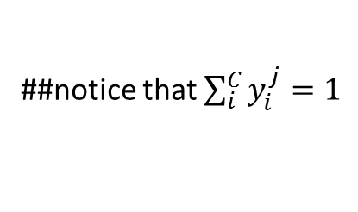
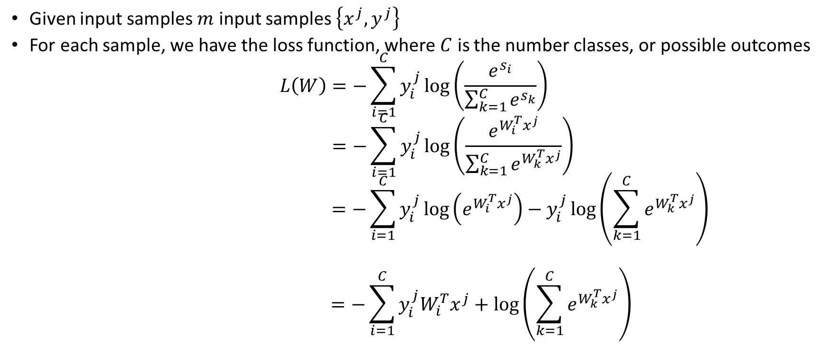
Gradient of Cross Entropy Loss
Given input samples $m$ input samples $\left\{x^{j},y^{j}\right\}$
For each sample, we have the loss function, where $C$ is the number classes, or possible outcomes
$$L\left(W\right)=−\sum_{i=1}^{C}{y_{i}^{j}\log\left(\frac{e^{s_{i}}}{\sum_{k=1}^{C}{e^{s_{k}}}}\right)}$$
$$=−\sum_{i=1}^{C}{y_{i}^{j}\log\left(\frac{e^{W_{i}^{T}x^{j}}}{\sum_{k=1}^{C}{e^{W_{k}^{T}x^{j}}}}\right)}$$
$$=−\sum_{i=1}^{C}{y_{i}^{j}\log\left(e^{W_{i}^{T}x^{j}}\right)−y_{i}^{j}\log\left(\sum_{k=1}^{C}{e^{W_{k}^{T}x^{j}}}\right)}$$
$$=−\sum_{i=1}^{C}{y_{i}^{j}W_{i}^{T}x^{j}+\log\left(\sum_{k=1}^{C}{e^{W_{k}^{T}x^{j}}}\right)}$$
##notice that $\sum_{i}^{C}{y_{i}^{j}=1}$

Slide 20
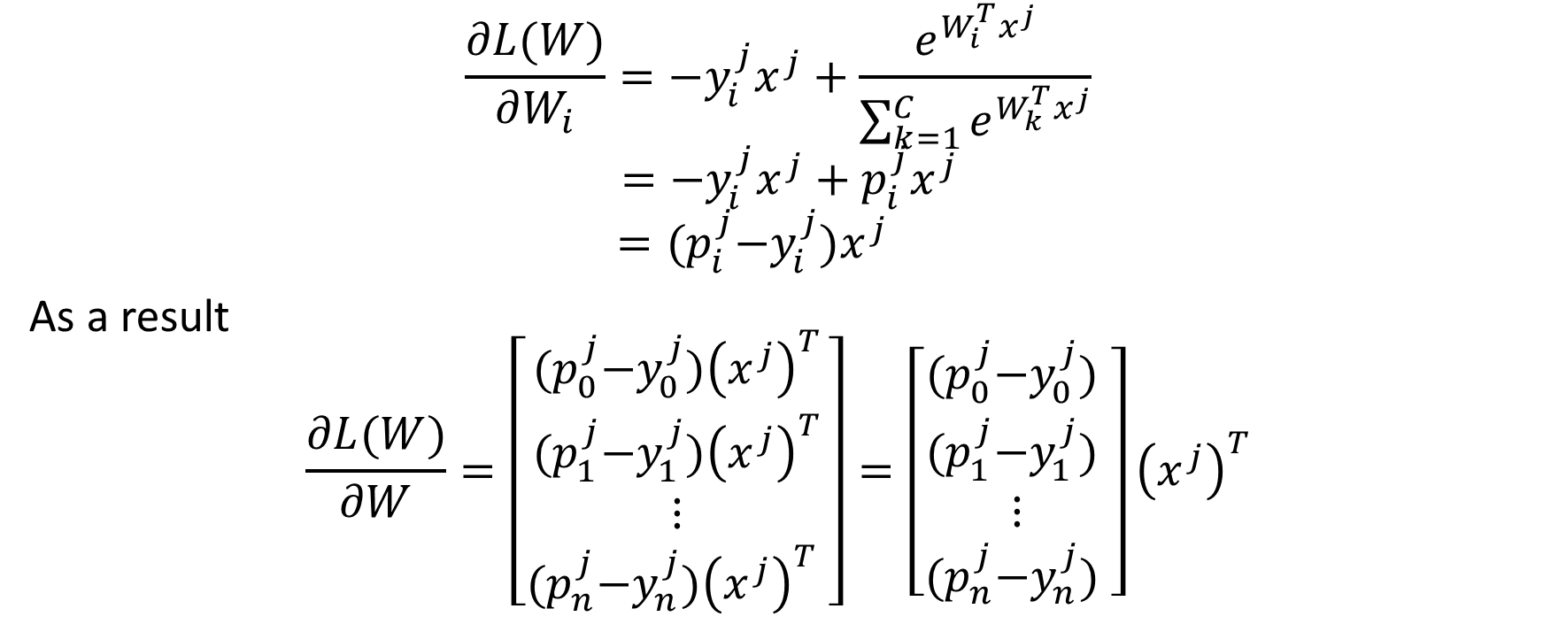
Gradient of Cross Entropy Loss
$$\frac{∂L(W)}{∂W_{i}}=−y_{i}^{j}x^{j}+\frac{e^{W_{i}^{T}x^{j}}}{\sum_{k=1}^{C}{e^{W_{k}^{T}x^{j}}}}$$
$$=−y_{i}^{j}x^{j}+p_{i}^{j}x^{j}$$
$$={(p}_{i}^{j}−y_{i}^{j})x^{j}$$
As a result
$$\frac{∂L(W)}{∂W}=\left[\begin{matrix}{(p}_{0}^{j}−y_{0}^{j}){\left(x^{j}\right)}^{T} \\ \begin{aligned}{(p}_{1}^{j}−y_{1}^{j}){\left(x^{j}\right)}^{T} \\ ⋮\end{aligned} \\ {(p}_{n}^{j}−y_{n}^{j}){\left(x^{j}\right)}^{T} \end{matrix}\right]=\left[\begin{matrix}{(p}_{0}^{j}−y_{0}^{j}) \\ \begin{aligned}{(p}_{1}^{j}−y_{1}^{j}) \\ ⋮\end{aligned} \\ {(p}_{n}^{j}−y_{n}^{j}) \end{matrix}\right]{\left(x^{j}\right)}^{T}$$

Slide 21
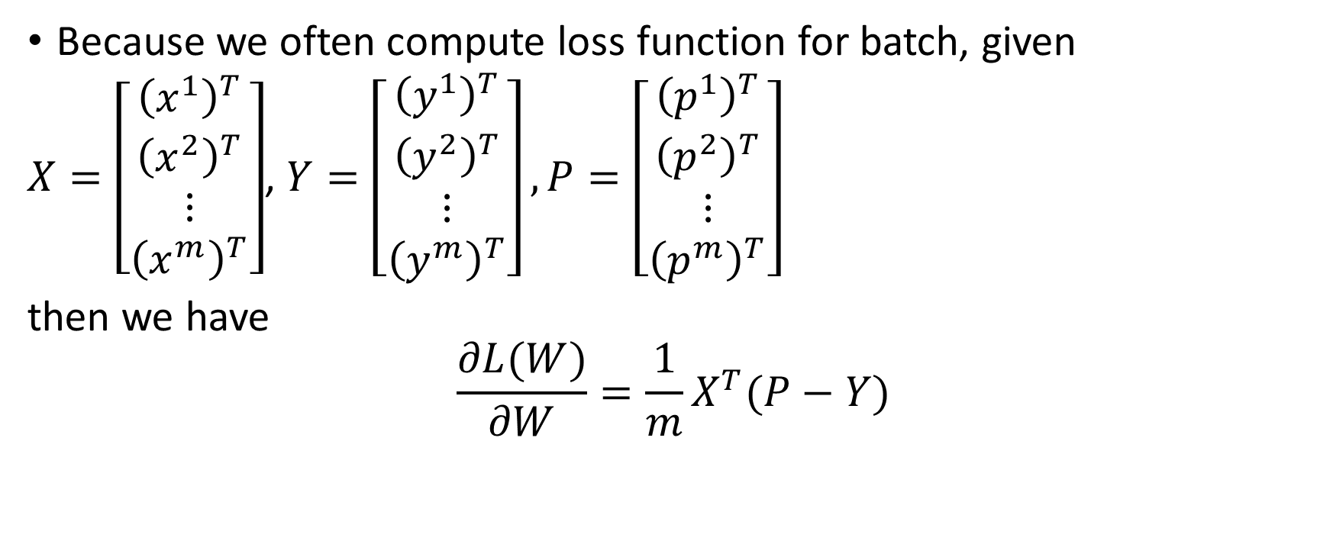
Batch Gradient of Cross Entropy Loss
Because we often compute loss function for batch, given
$X=\left[\begin{matrix}{\left(x^{1}\right)}^{T} \\ {\left(x^{2}\right)}^{T} \\ \begin{aligned}⋮ \\ {\left(x^{m}\right)}^{T}\end{aligned}\end{matrix}\right]$, $Y=\left[\begin{matrix}{\left(y^{1}\right)}^{T} \\ {\left(y^{2}\right)}^{T} \\ \begin{aligned}⋮ \\ {\left(y^{m}\right)}^{T}\end{aligned}\end{matrix}\right],P=\left[\begin{matrix}{\left(p^{1}\right)}^{T} \\ {\left(p^{2}\right)}^{T} \\ \begin{aligned}⋮ \\ {\left(p^{m}\right)}^{T}\end{aligned}\end{matrix}\right]$
then we have
$$\frac{∂L(W)}{∂W}={\frac{1}{m}X}^{T}(P−Y)$$

Slide 22

What about the Gradient of Regularization?
$$\frac{∂L(W)}{∂W}={\frac{1}{m}X}^{T}\left(P−Y\right)+2λW$$

Slide 23
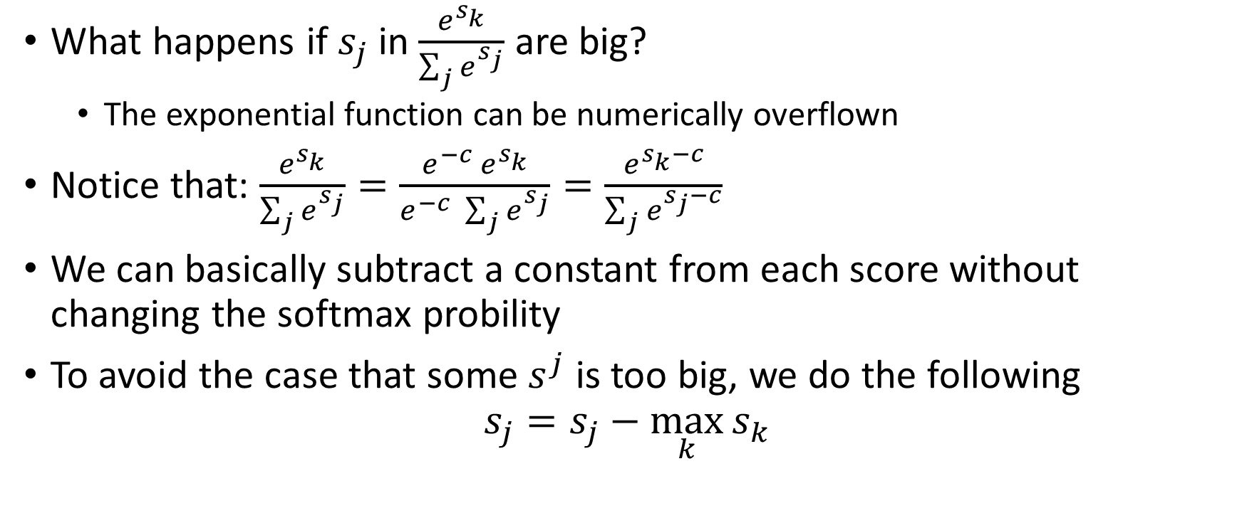
Stable Softmax
What happens if $s_{j}$ in $\frac{e^{s_{k}}}{\sum_{j}{e^{s_{j}}}}$ are big?
The exponential function can be numerically overflown
Notice that: $\frac{e^{s_{k}}}{\sum_{j}{e^{s_{j}}}}=\frac{{e^{−c} e}^{s_{k}}}{e^{−c} \sum_{j}{e^{s_{j}}}}=\frac{e^{s_{k}−c}}{\sum_{j}{e^{s_{j}−c}}}$
We can basically subtract a constant from each score without changing the softmax probility
To avoid the case that some $s^{j}$ is too big, we do the following
$$s_{j}=s_{j}−\max_{k}{s_{k}}$$

